Slide 1
PowerShell Script Analyzer Rules
Fred Bainbridge
Fredbainbridge.com
Wells Fargo
Jeff Scripter
mnscug.org
Wells Fargo

Slide 2
Fred Bainbridge
Jeff Scripter
@FredBainbridge
@JeffTheScripter
Microsoft MVP
Accomplished Professional
15 years
15 years
Beer and Baseball
Beer and Coffee

Slide 3
What is the Script Analyzer?
Who is using this today?
Notes:
General Banter slide.
Who is familiar with this? Who uses it currently? Etc? (gauging the audience questions, probably no slide)
If you use it, How do you use it? Custom rules? Formatter? What are you using it for today? Do you plan to use it?
A module that helps you adhere to coding "best practices". Everyone codes a little bit differently but when it comes time for collaboration between team mates and the maintainability of code going forward it is important to adhere to agreed upon standards. The PS Script analyzer can help you maintain high quality code and the code your peers / team. Think of it as a grammar auto-correct for your scripts..
The look and feel of your code should match across projects and from script to script. Things like function layouts, names, module names, variable names, etc all have the same "flavor" from script to script. This is double important when working with teams Since you want ensure that your code is readable and maintainable in the long run.

Slide 4
Why the Script Analyzer?
Maintaining code quality is hard work.
Notes:
You need high quality code this helps keep you accountable to that. Everyone is human, mistakes get made after long hours of coding or late night sessions. You don’t have defined coding standards yet? What? Why!? (Heads up, few do). That’s totally ok, outsource that responsibility to microsoft and let the PSScriptAnalyzer be your new PowerShell baseline.
This can speed up your peer review by removing lots of simple and low hanging fruit.

Slide 5
Demo!
What comes out of the box?
https://github.com/fredbainbridge/CustomPSScriptAnalyzerRules

Slide 6
Another Reason Why.
You can create your own rules!
Notes:
You can create your own rules to match your needs or coding standards. We are going to go into a deep dive about creating custom rules, but first let's take a look at some good examples of custom rules.

Slide 7
Demo!
Function Naming Standards
https://github.com/fredbainbridge/CustomPSScriptAnalyzerRules

Slide 8
The Community Rules.
Yes it does.
https://github.com/PowerShell/PSScriptAnalyzer/tree/development/Tests/Engine/CommunityAnalyzerRules
Notes:
This is mainly to show a bunch of working examples to use as reference. These are well constructed rules in actual PowerShell as opposed to compiled code. The Microsoft supplied rules are all in c#. These is by far and away the greatest (and really, only source for script analyzer rules written in PowerShell.) Seriously, there isn't must else out there that I would consider valuable information.

Slide 9
Demo!
The Community Rules.

Slide 10
More Reasons Why!
You can automate all of this. (Duh, its PowerShell)
Notes:
You can automate this. (Duh, its PowerShell)
Run this against your entire repository on each check in.
Run this against all your Cis in ConfigMgr. (win32_product)

Slide 11
Demo! Short Variable Names
$i see what you did there.
https://github.com/fredbainbridge/CustomPSScriptAnalyzerRules

Slide 12
EVEN More Reasons Why!
You need to follow the rules to publish your code to the PowerShell Gallery.
Notes:
You need to follow the rules to publish code to ps gallery. If you ever want to share your code beyond your organization you will need to follow these rules to the T, no exceptions. The PowerShell gallery will automatically reject any code that does has any ps script analyzer rules violations.
Safety! You can do some really dangerous things with PowerShell, like clear text passwords. Unsigned scripts.

Slide 13
Creating your own Rules
The fun stuff.

Slide 14
What is happening here?
You are writing a module. (.psm1 file)
Q: What is a script analyzer rule doing?
A: It is taking a script block and testing it based on your conditions.
Notes:
DEMO – look at folder structure.
C:\source\repos\CustomPSScriptAnalyzerRules\ScriptAnalyzerRules\Rules\mmsPSScriptAnalyzerRules

Slide 15

What is happening here? ScripTBlock Edition
What is a script block?
Is it a string? No. It is a specific object type.
https://docs.microsoft.com/en-us/dotnet/api/system.management.automation.scriptblock?view=powershellsdk-1.1.0
The entirety of a ps1 file gets treated as a script block (generally) when using the script analyzer.

Slide 16
What is happening here? AST EDITION
System.Management.Automation is a common namespace you will be working with.
A script block is automatically converted to a collection of AST (Abstract Syntax Tree) objects. AST objects are the representation of your functions, variables, tokens, etc.
You might be amazed to see how far and to what level of detail a script block gets broken down into.
https://docs.microsoft.com/en-us/dotnet/api/system.management.automation.language?view=powershellsdk-1.1.0
Notes:
The AST conversion happens under the hood when you call the script analyzer.

Slide 17
Breaking down a script into AST objects.
https://github.com/fredbainbridge/CustomPSScriptAnalyzerRules

Slide 18
What is happening here? AST Filtering
You can then filter the Collection of AST objects to only return the ones you are interested in. i.e. Functions or a specific token.
How can I find interrogate just the AST objects I care about?

Slide 19
Filtering AST objects. (Predicates)
https://github.com/fredbainbridge/CustomPSScriptAnalyzerRules

Slide 20
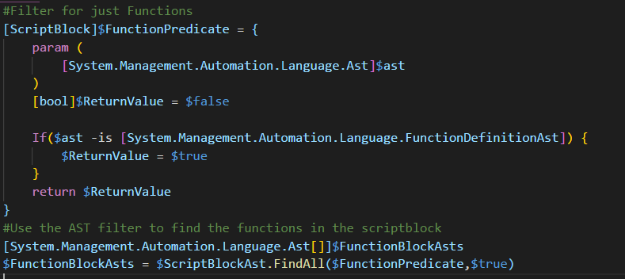
Predicate Example
Notes:
Did you know script blocks can take parameters? Neato, right?
There are a couple of different ways to do this. Some are elegant some are not. We prefer using was we call the "predicate approach" to filter down a collection of AST objects into what we are looking for specifically.
Getting only the AST objects you care about. I recommend using this predicate approach. You essentially define a script block that you will use as a search filter.
This gives you a collections of the all the specific AST types you were looking for based on your predicate.
*This isn't the only do it, you can loop through each AST object instead of using FindAll(), and there are probably 100 other ways to do it. But, the important thing is that you are consistent in how you do it from rule to rule. (maybe have a script analyzer rule for you rules.)

Slide 21
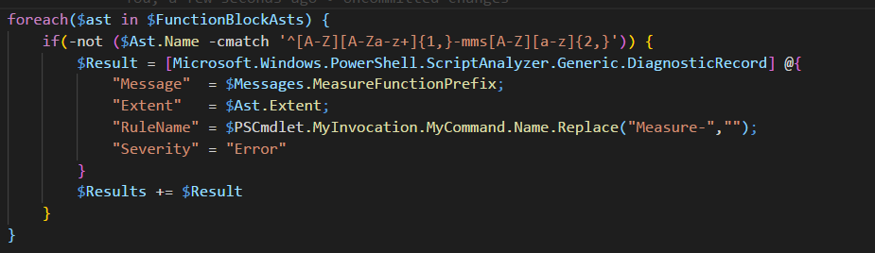
Test your Results
Notes:
Psuedo Code - if this isnt what I am expecting, I am returning this diagnostic record back to you.
Get familiar with Regular expressions. It certainly helps.
Be aware, not all AST objects have the same properties. Functions and CommandObjects will have different properties for examples. i.e. Ast.Name above may not exist in whatever AST you are looking at.

Slide 22
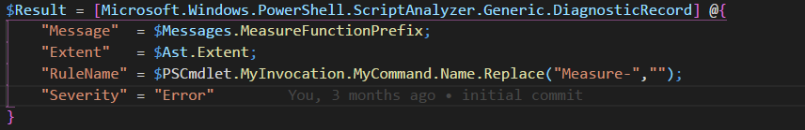
DiagnosticRecord
This is splatting parameters to the Diagnostic record constructor.
Message - this is just a string that is displayed to the user. We wrapped it up using a little helper to make the code prettier. It is not needed. "Message“ = "you wrote bad code here" would work too.
Extent: This is the line number and some other meta data about your AST in relation to the bigger script.
Rule Name: This is the rule name returned. (displayed to user)
Severity: Error, Warning, Info. This must be exact.

Slide 23
Testing for Tokens!
$object | Slow-DownMyScript
https://github.com/fredbainbridge/CustomPSScriptAnalyzerRules
Notes:
Conversation - who hear likes the PowerShell |? Yea? Use it all the time? Would you believe me when I tell you it is a slow burdensome memory hog and should be avoided? Talk about why the pipe sucks for a minute.

Slide 24
Integrating custom rules with VS Code
https://github.com/fredbainbridge/CustomPSScriptAnalyzerRules
Notes:
Conversation - who hear likes the PowerShell |? Yea? Use it all the time? Would you believe me when I tell you it is a slow burdensome memory hog and should be avoided? Talk about why the pipe sucks for a minute.

Slide 25
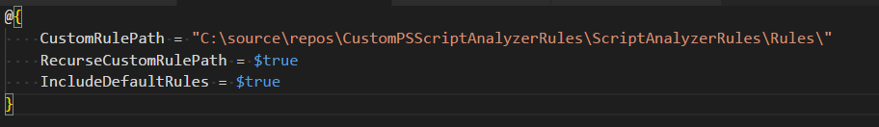
Integrating With VS Code
1. Create a CodeFormatting.psd1
2. Configure the PowerShell extension to use this code formatting definition.
Notes:
Hat tip to Ryan Ephgrave

Slide 27


Slide 28
Title
Line1
Bullet Level 1
Bullet Level 2
Bullet Level 3

Slide 29
Title
Code

Slide 30
Text Only with Border
Level 1
Level 2
Level 3

Slide 31
Text Only (Red)
Level 1
Level 2
Level 3

Slide 32
Title
Text 1
Level 1
Level 2
Level 3
Text 2
Level 1
Level 2
Level 3

Slide 33
Title
Section 1
Section 2
Text
Level 1
Level 2
Level 3
Text
Level 1
Level 2
Level 3

Slide 34





























Slide 35






























Slide 36




























Slide 37




























Slide 38




























Slide 39




























Slide 40




























Slide 41























Slide 42
















